Slide 1




Pizza Dashboard
Pizza Sales Analysis
View in Power BI
Prepared By: Rajan Patel
View in Power BI
Prepared By: Rajan Patel

Slide 2
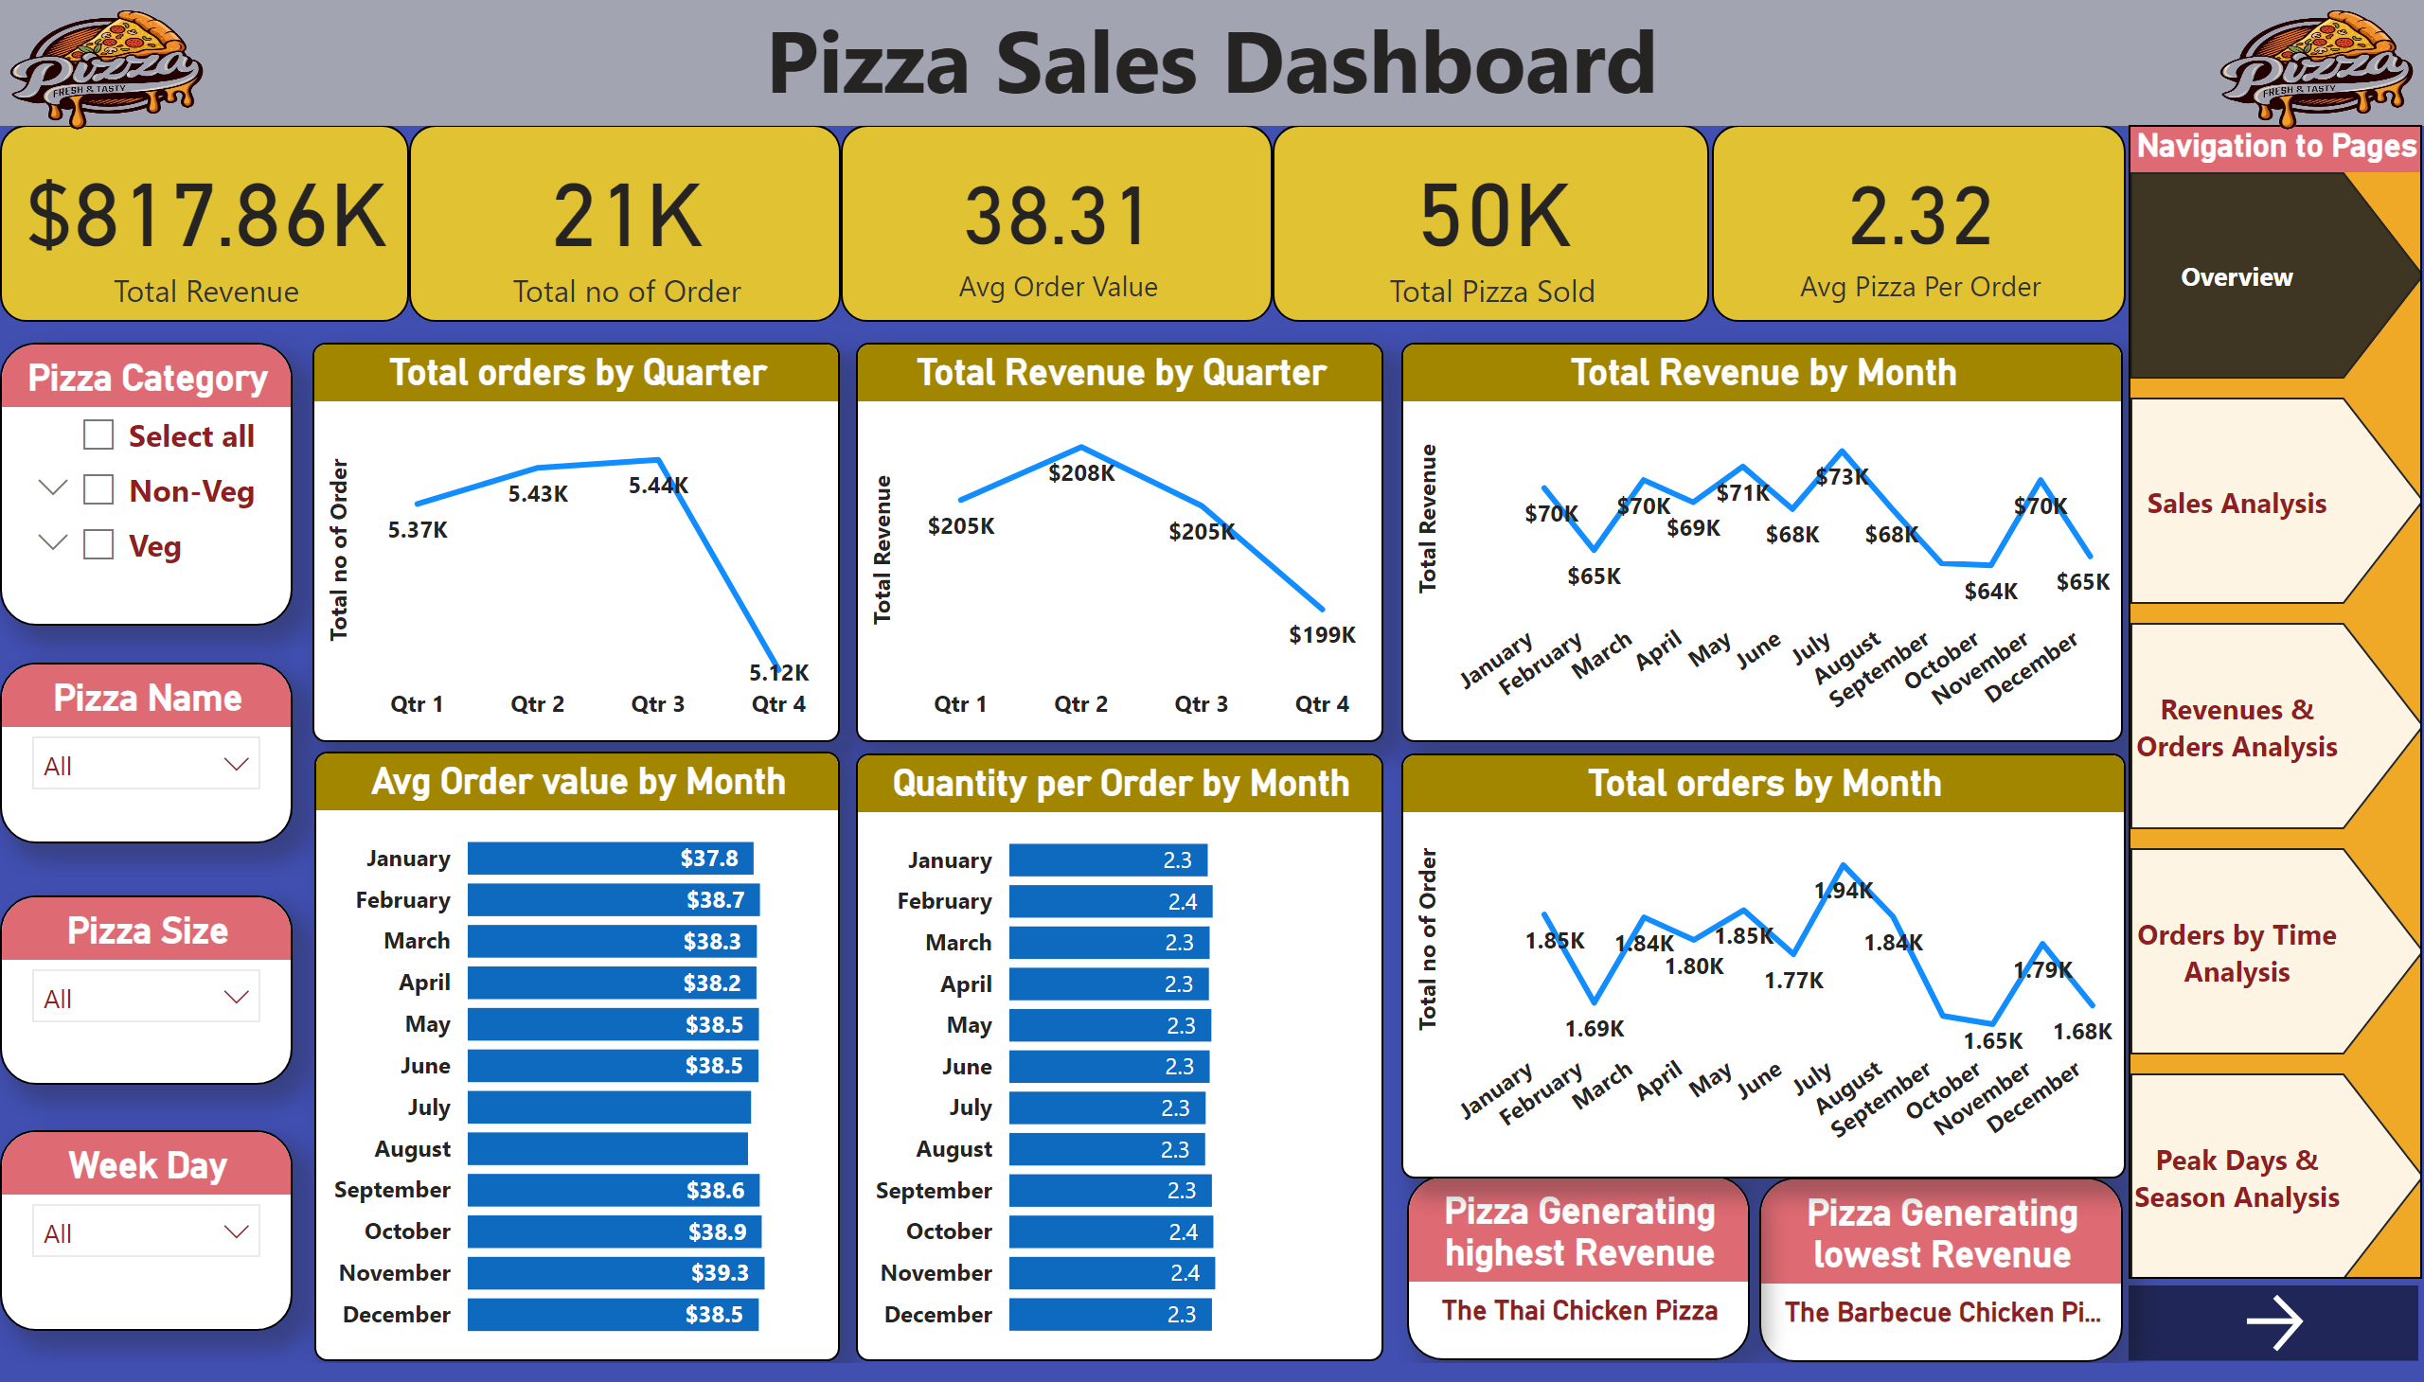
Overview
Notes:
card
No alt text provided
card
No alt text provided
card
No alt text provided
card
No alt text provided
card
No alt text provided
Pizza Sales Dashboard
No alt text provided
Pizza Category
No alt text provided
Pizza Name
No alt text provided
Pizza Size
No alt text provided
Week Day
No alt text provided
Pizza Generating lowest Revenue
No alt text provided
Pizza Generating highest Revenue
No alt text provided
Total orders by Quarter
No alt text provided
lineChart
No alt text provided
Total Revenue by Month
No alt text provided
Total orders by Month
No alt text provided
Avg Order value by Month
No alt text provided
Navigation to Pages
No alt text provided
actionButton
No alt text provided
image
No alt text provided
Quantity per Order by Month
No alt text provided
image
No alt text provided

Slide 3
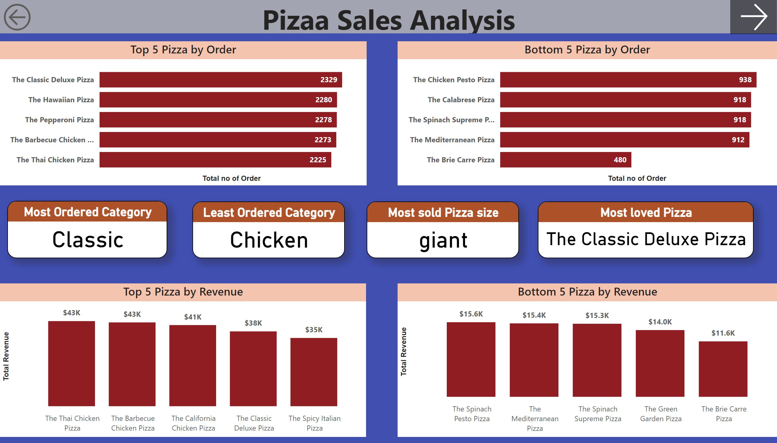
Sales Analysis
Notes:
Pizaa Sales Analysis
No alt text provided
Top 5 Pizza by Revenue
No alt text provided
actionButton
No alt text provided
Top 5 Pizza by Order
No alt text provided
Bottom 5 Pizza by Order
No alt text provided
Bottom 5 Pizza by Revenue
No alt text provided
Most Ordered Category
No alt text provided
Least Ordered Category
No alt text provided
actionButton
No alt text provided
Most sold Pizza size
No alt text provided
Most loved Pizza
No alt text provided

Slide 4
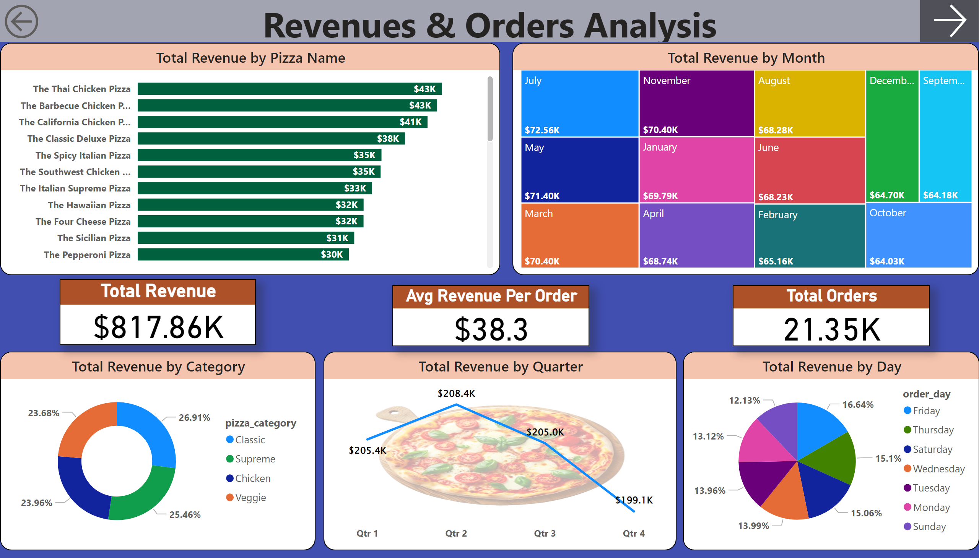
Revenues & Orders Analysis
Notes:
Revenues & Orders Analysis
No alt text provided
actionButton
No alt text provided
lineChart
No alt text provided
Total Revenue by Month
No alt text provided
Total Revenue by Day
No alt text provided
Total Revenue by Pizza Name
No alt text provided
Total Revenue by Category
No alt text provided
Total Revenue
No alt text provided
Avg Revenue Per Order
No alt text provided
Total Orders
No alt text provided
actionButton
No alt text provided

Slide 5
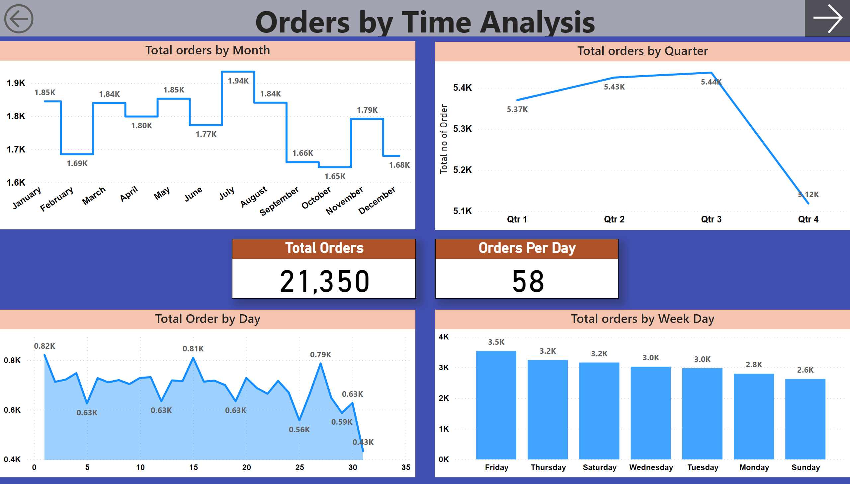
Orders by Time Analysis
Notes:
Orders by Time Analysis
No alt text provided
Total orders by Quarter
No alt text provided
Total orders by Month
No alt text provided
Total Order by Day
No alt text provided
Total Orders
No alt text provided
Total orders by Week Day
No alt text provided
Orders Per Day
No alt text provided
actionButton
No alt text provided
actionButton
No alt text provided

Slide 6
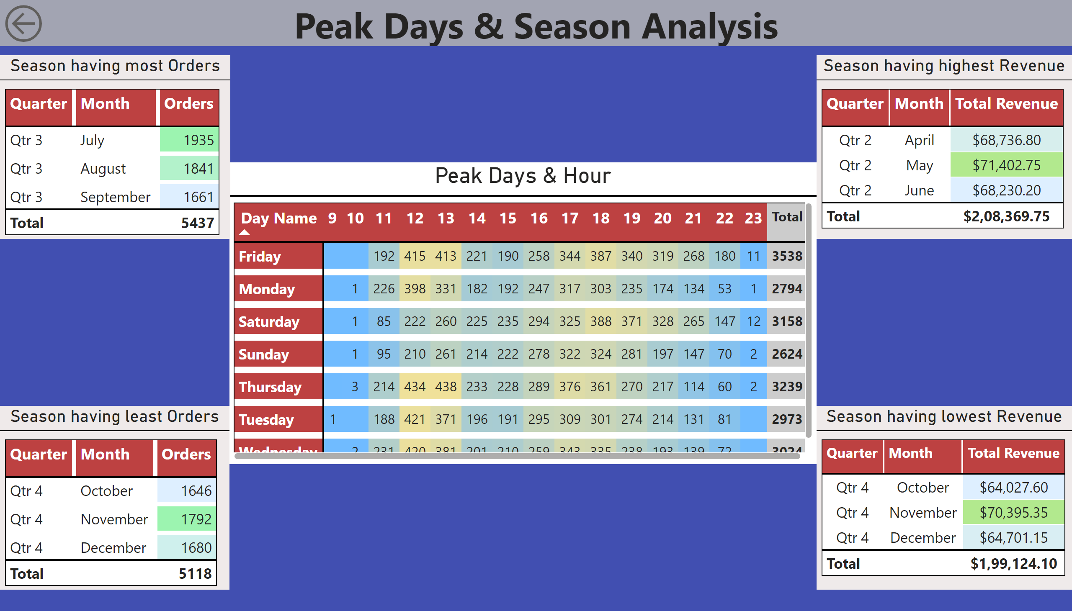
Peak Days & Season Analysis
Notes:
Peak Days & Season Analysis
No alt text provided
actionButton
No alt text provided
Peak Days & Hour
No alt text provided
Season having most Orders
No alt text provided
Season having highest Revenue
No alt text provided
Season having least Orders
No alt text provided
Season having lowest Revenue
No alt text provided

